Slide 1
Performance Analysis
DevTools Basics

Slide 2
DON’T GUESS 🤔
MEASURE 📐!

Slide 3
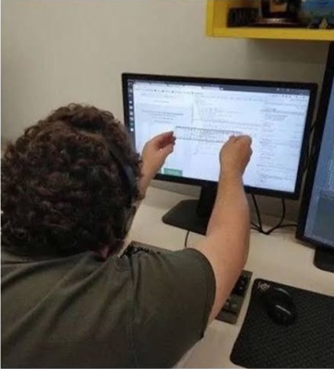
DON’T GUESS 🤔
MEASURE 📐!

Slide 4
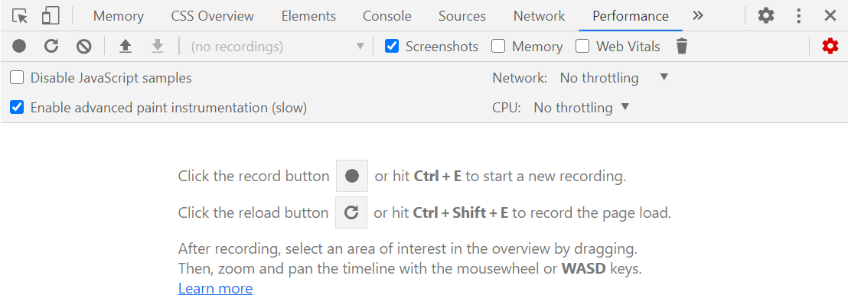
Open DevTools Performance Tab
Open DevTools
Ctrl
Shift
i

Slide 5
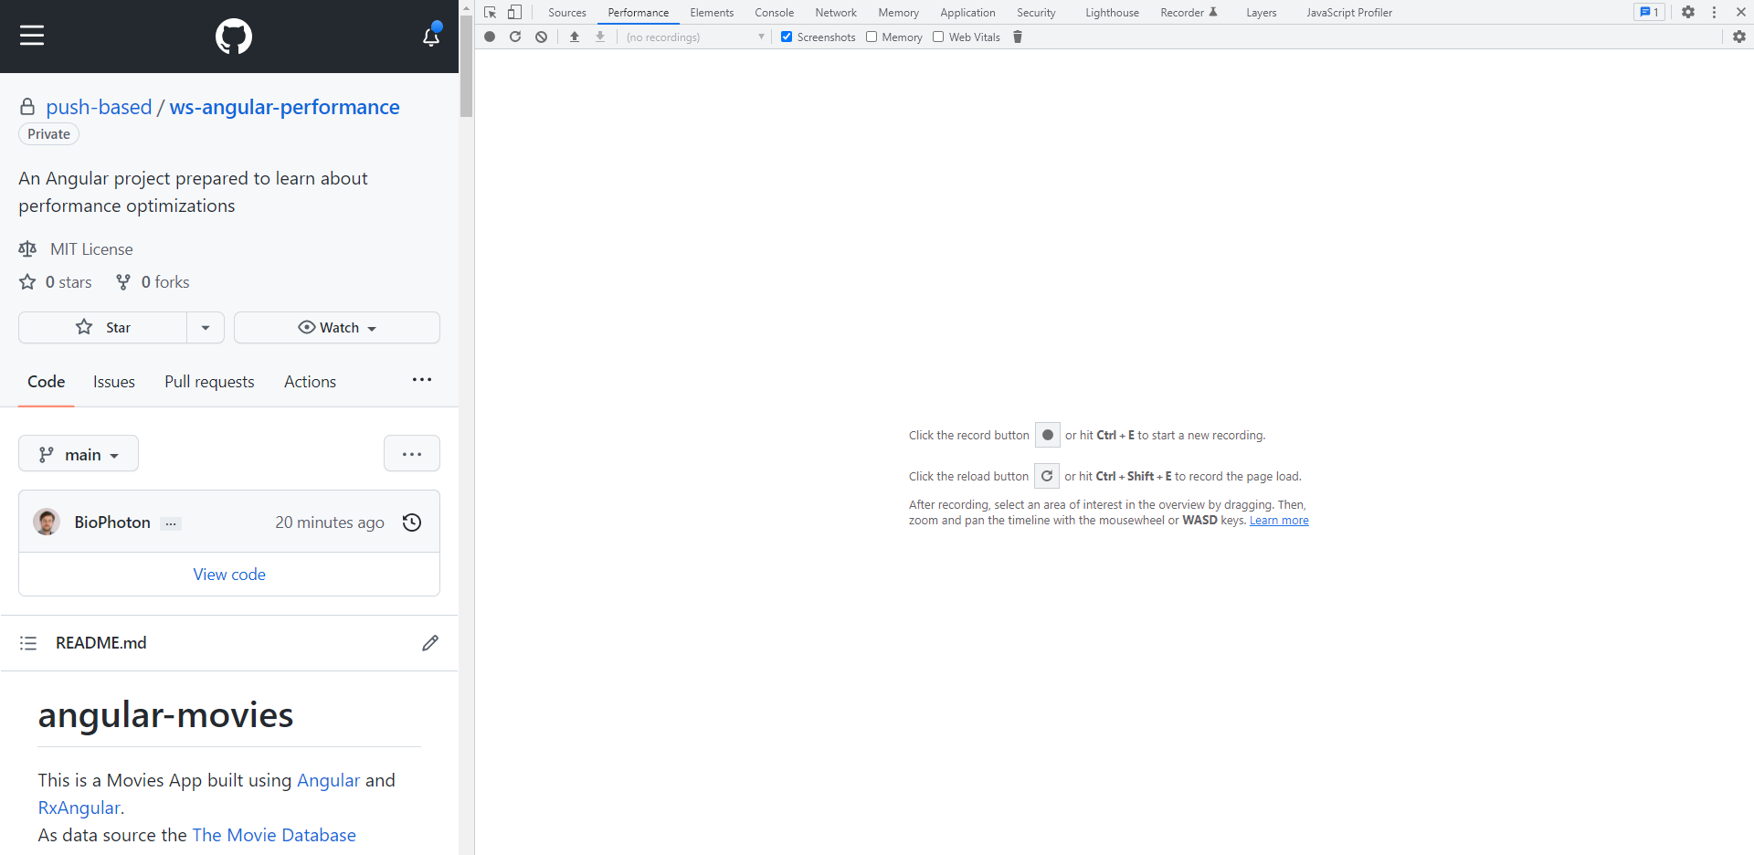
Start Recording
Ctrl
E
Record refresh
Ctrl
Shift
E

Slide 6
Throttling
Measure in *real* conditions

Slide 7
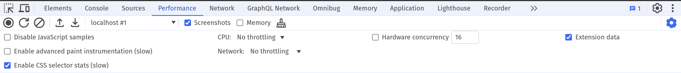
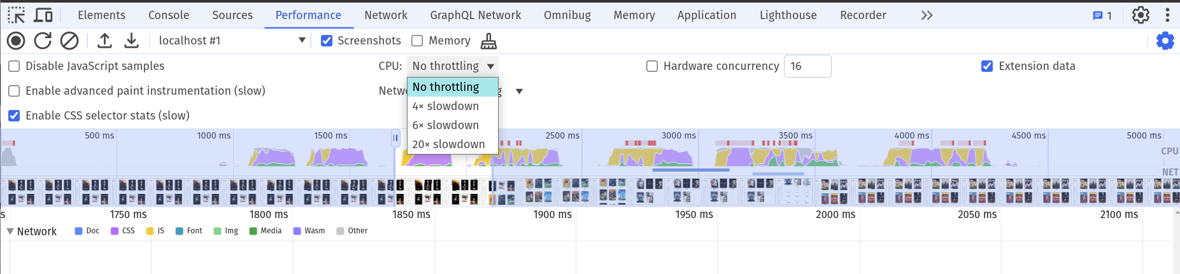
!!!RECOMMENDED!!!

Slide 8
Be careful, this can roast your system!

Slide 9
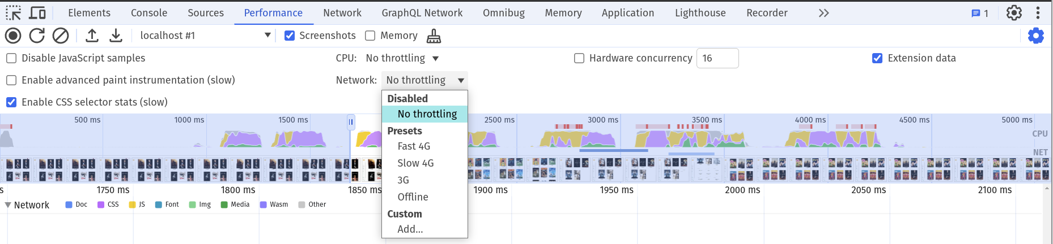
!!!RECOMMENDED!!!

Slide 10
Overview

Slide 11
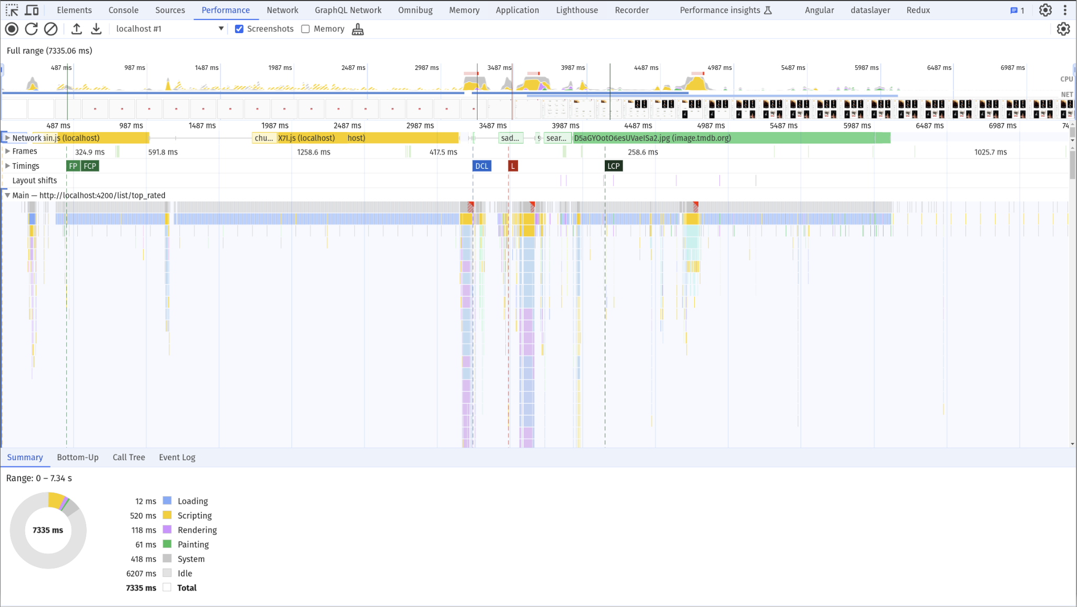
Minimap
Filmstrip
Tracks:
Network, Main, Worker, GPU, Frames, Timings
Main thread
Script Flame Chart
Summary

Slide 12
Minimap & Navigation

Slide 13
Minimap

Slide 14
Timeline

Slide 15
Timeline
Filmstrip

Slide 16
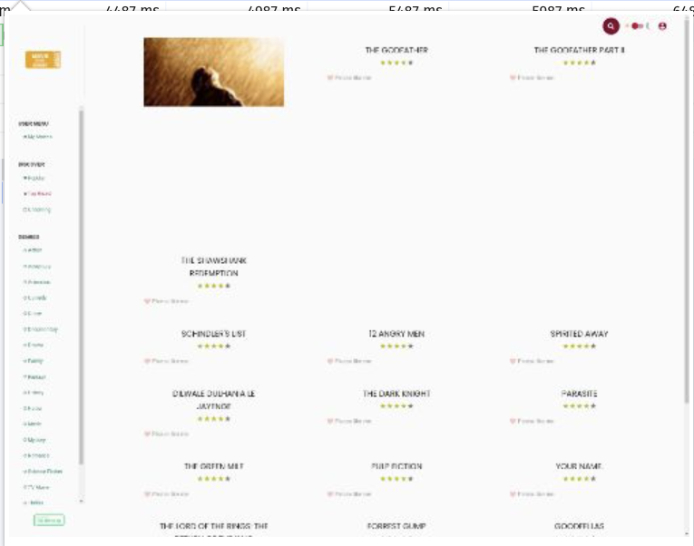
Timeline
👆️
Filmstrip

Slide 17
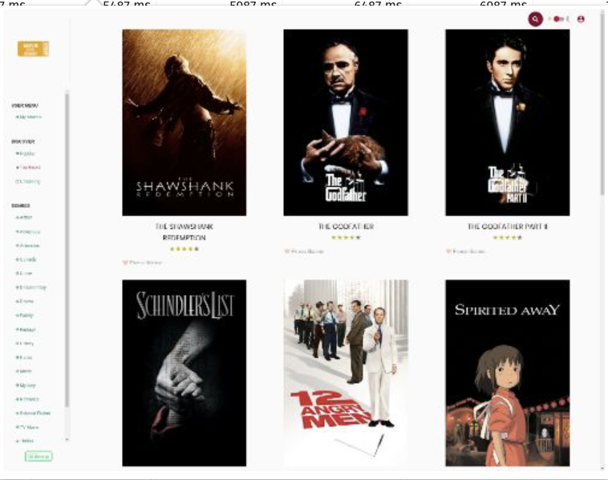
Timeline
👆️
Filmstrip

Slide 18
The timeline, tracks & summary are CONNECTED!

Slide 19
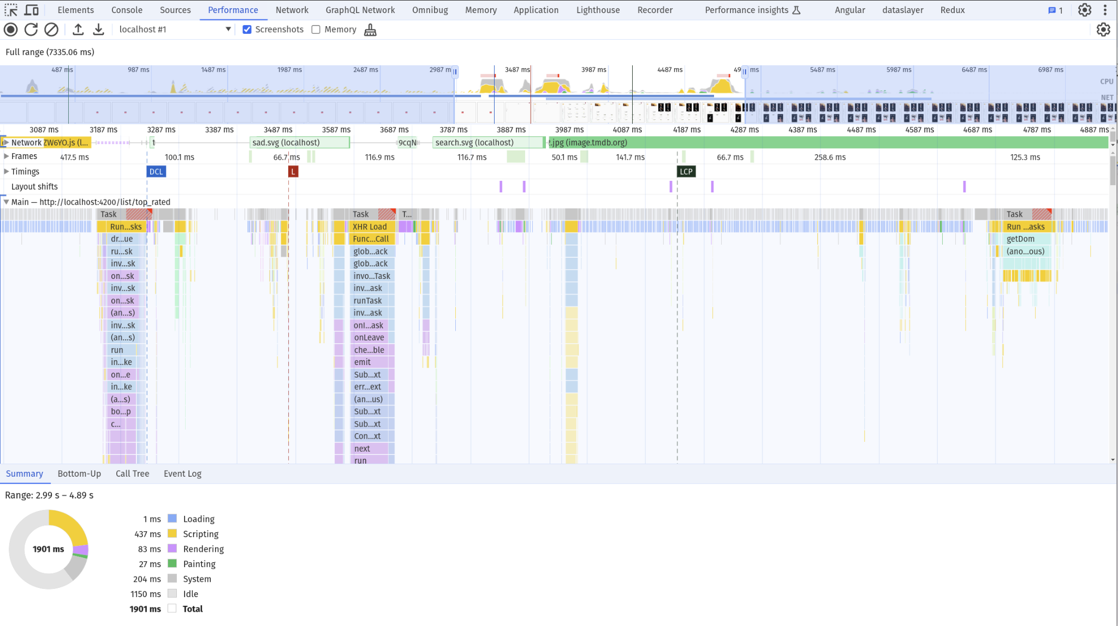
Select a range

Slide 20
Adjust selection / Navigate
🖱️
W
A
S
D
drag or scroll

Slide 21
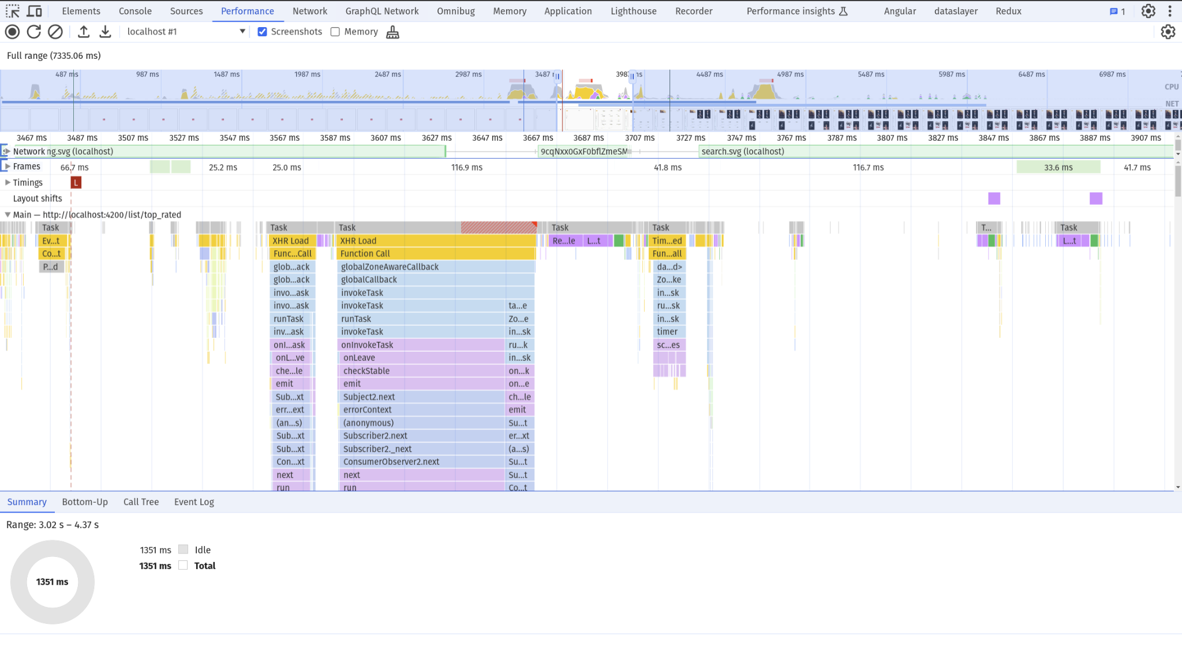
👉️👉️
👈️👈️
zoom in
🖱️
W
A
S
D
drag or scroll

Slide 22
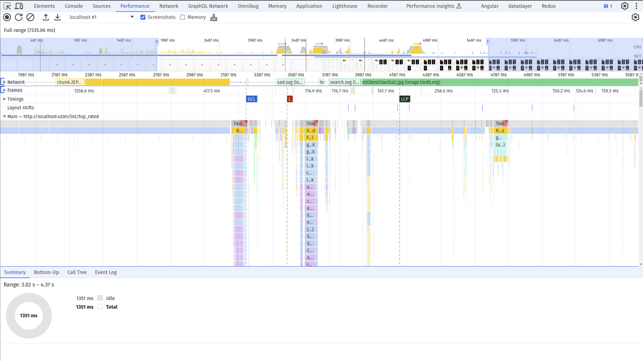
👈️👈️
👉️👉️
zoom out
🖱️
W
A
S
D
drag or scroll

Slide 23
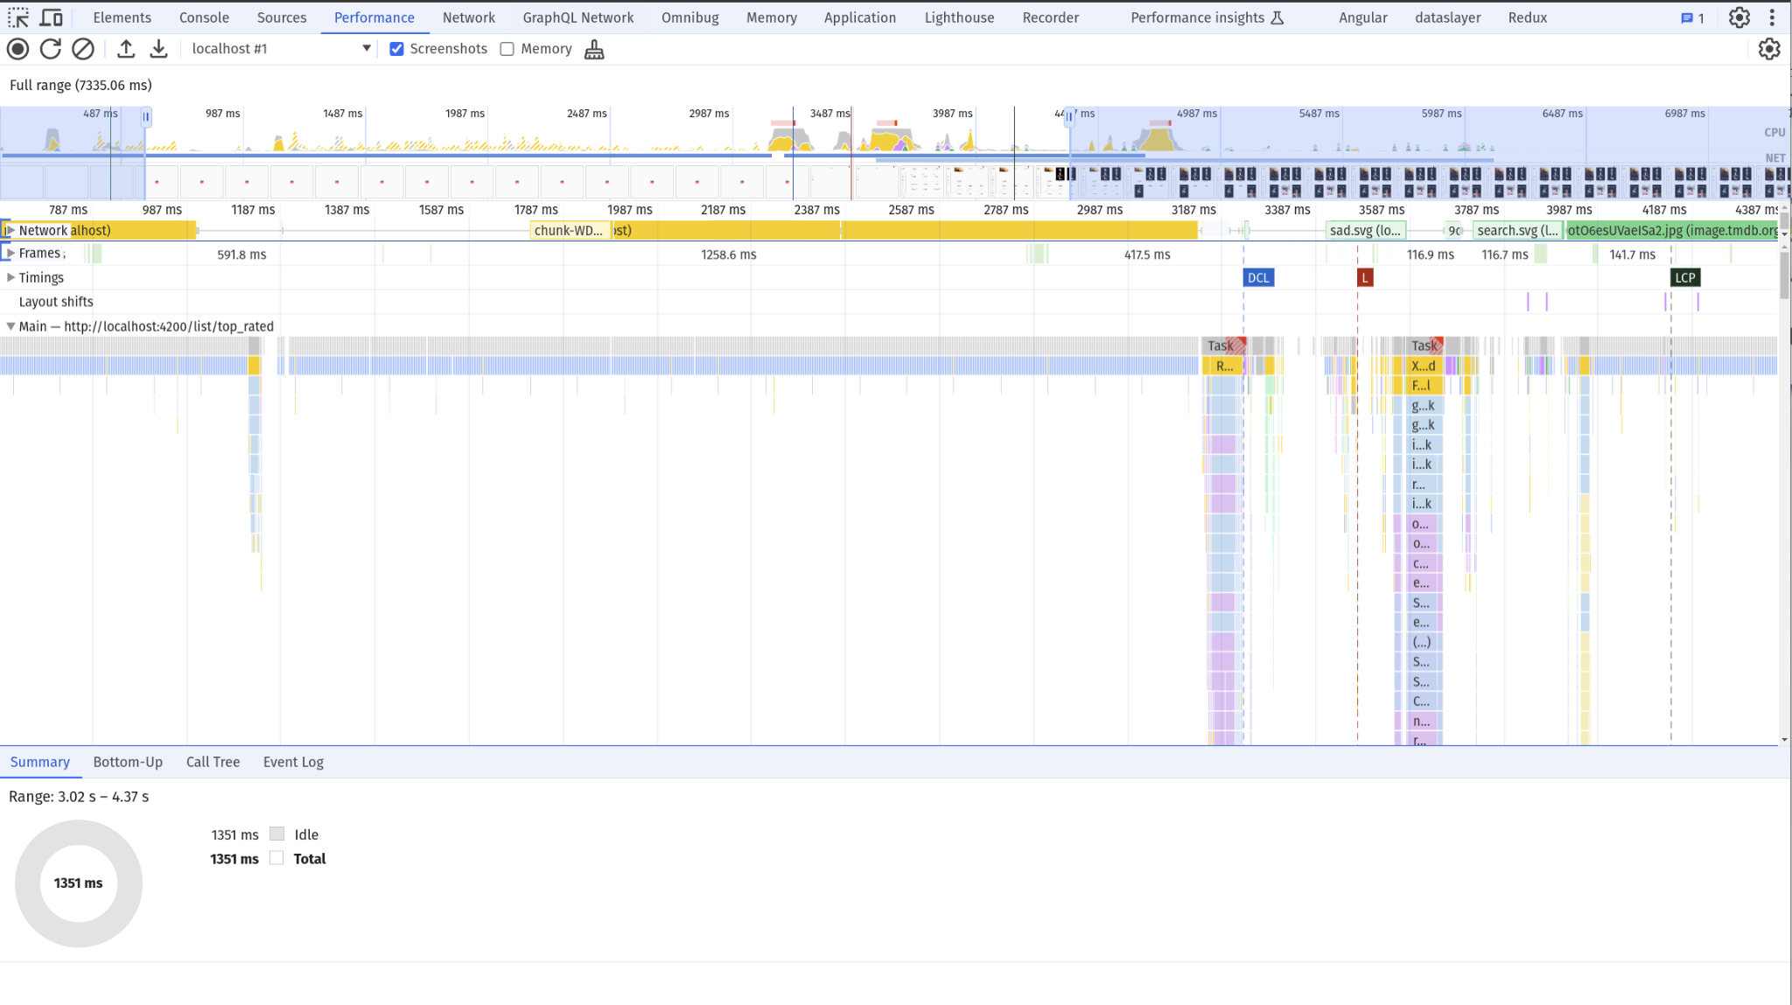
👈️👈️
👈️👈️
move left
🖱️
W
A
S
D
drag or scroll

Slide 24
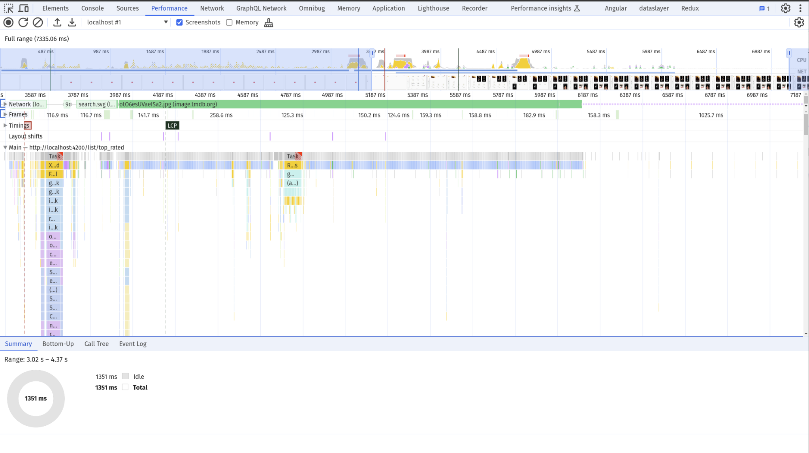
👉️👉️
👉️👉️
move right
🖱️
W
A
S
D
drag or scroll

Slide 25

Expand a Range

Slide 26
Expand a Range

Slide 27
Tracks

Slide 28
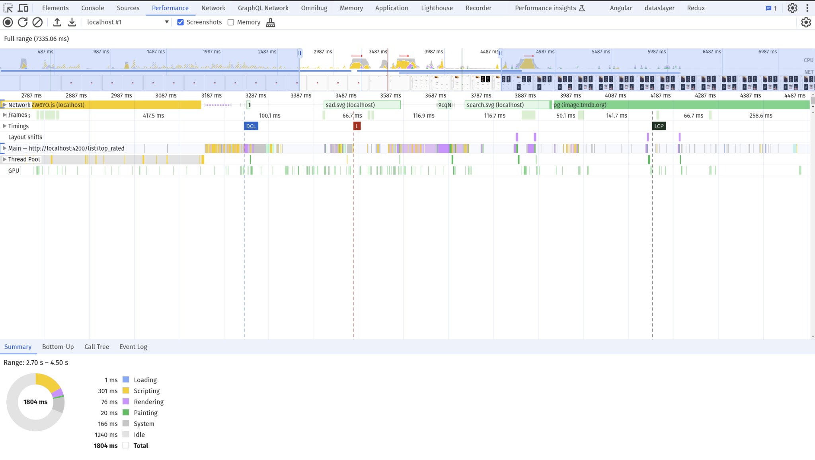

Slide 29


Slide 30
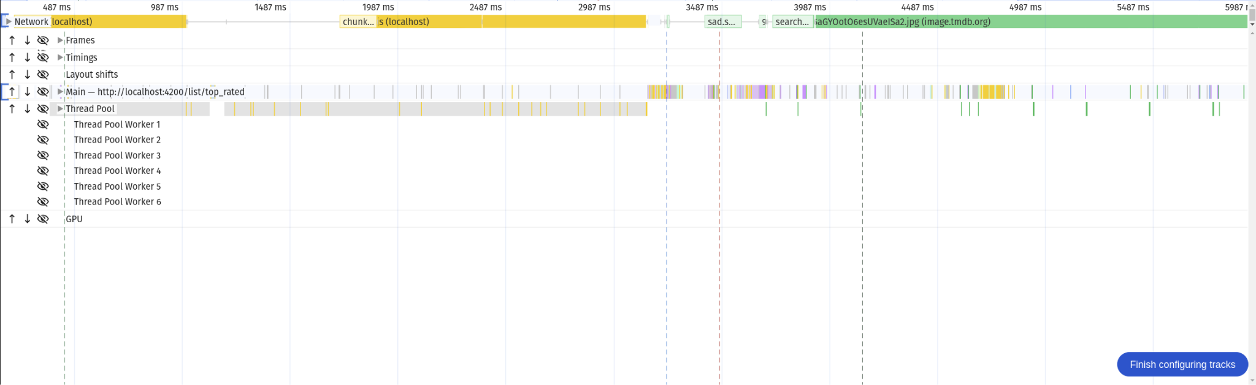

Slide 31
Network

Slide 32
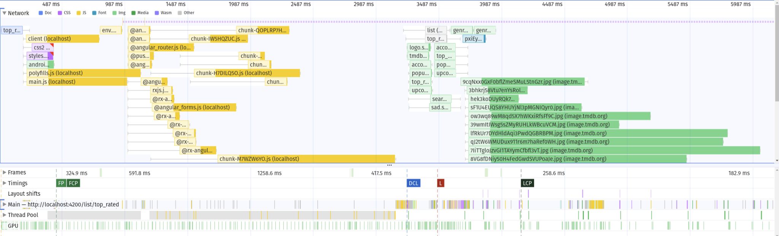
Network

Slide 33
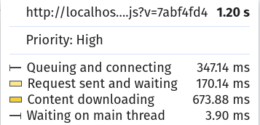
Network

Slide 34
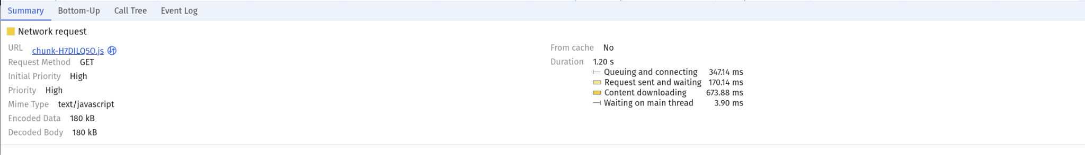
Network

Slide 35
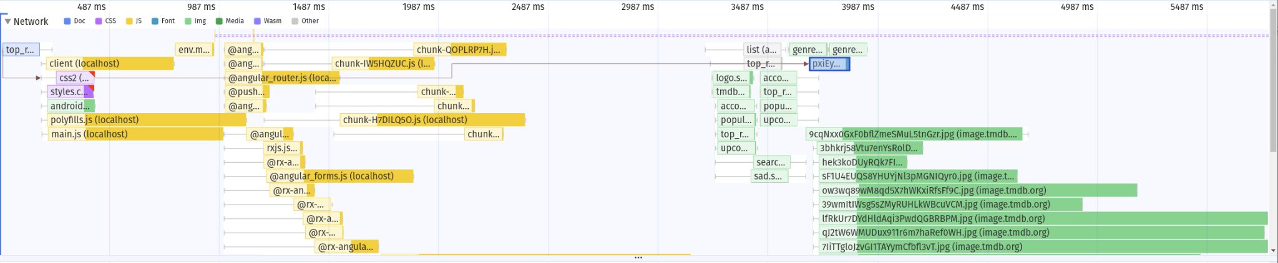
Network

Slide 36
Main

Slide 37
A task
Task
Event: click
work
otherWork
…
…
…
…

Slide 38
A task
any discrete piece of work that the browser does
Task
Browser Events
Event: click
work
otherWork
App Code
…
…
…
…
rendering & painting
… and more

Slide 39

Task Detail View
Task
Type
Event: click
work
work2
…
…
…
…
Scripting
Layout, Styles
Paint, Composite

Slide 40
Vertical Execution Callstacks
addEventListener('click', () => {
work();
work2();
});
Task
Event: click
work
work2
…
…
…
…

Slide 41
A long task
64.90 ms Task Long task took 64.90 ms
Task
Event: click
work
otherWork
…
…
…
…
a task that exceeds 50ms processing time

Slide 42
A long task
64.90 ms Task Long task took 64.90 ms
Task
Event: click
work
otherWork
…
…
…
…
blocking time: 14.9ms

Slide 43
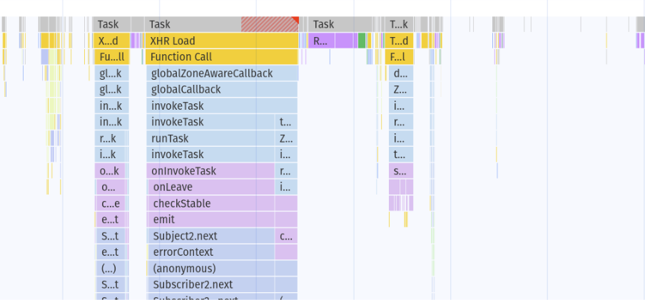
Main
Long Task
Macrotask
Browser Events
App Code
rendering & painting

Slide 44
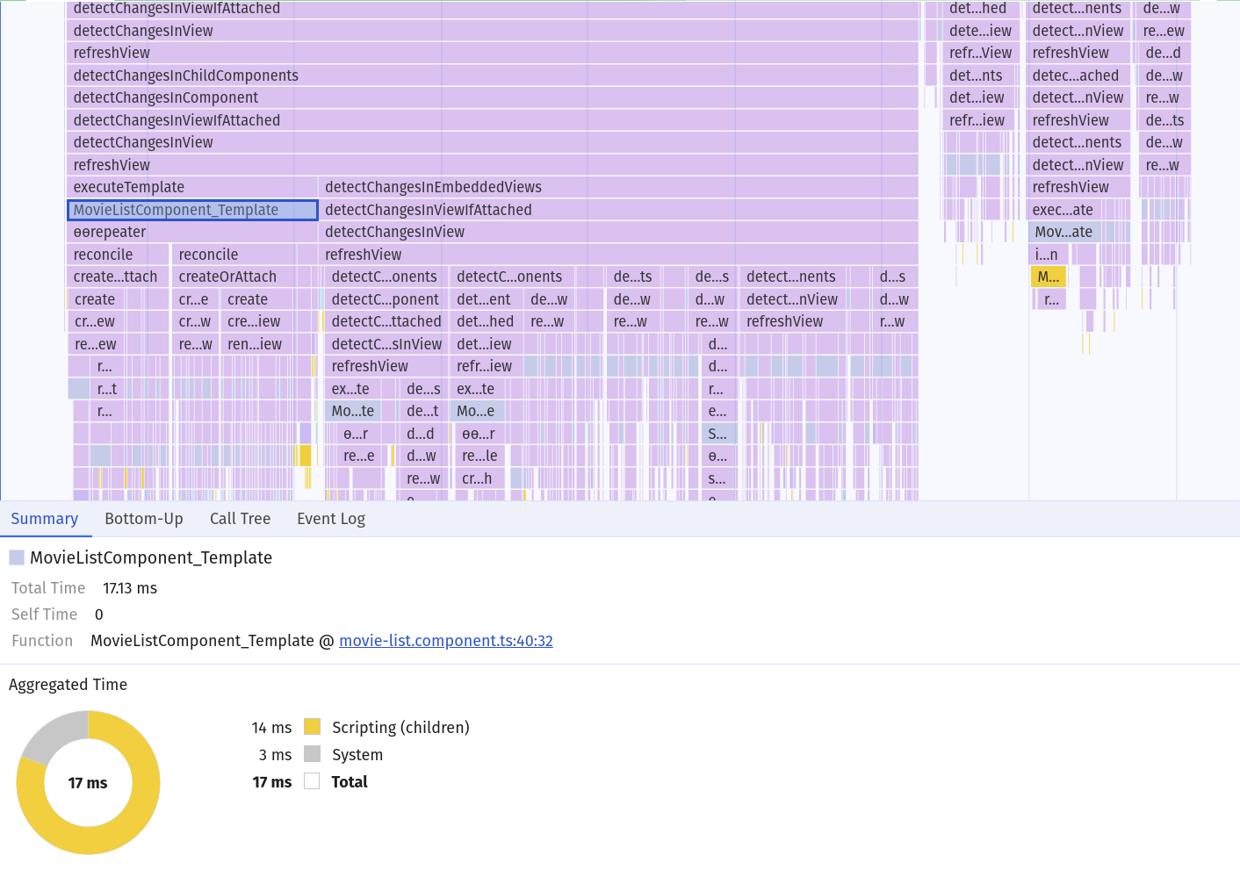
Main

Slide 45
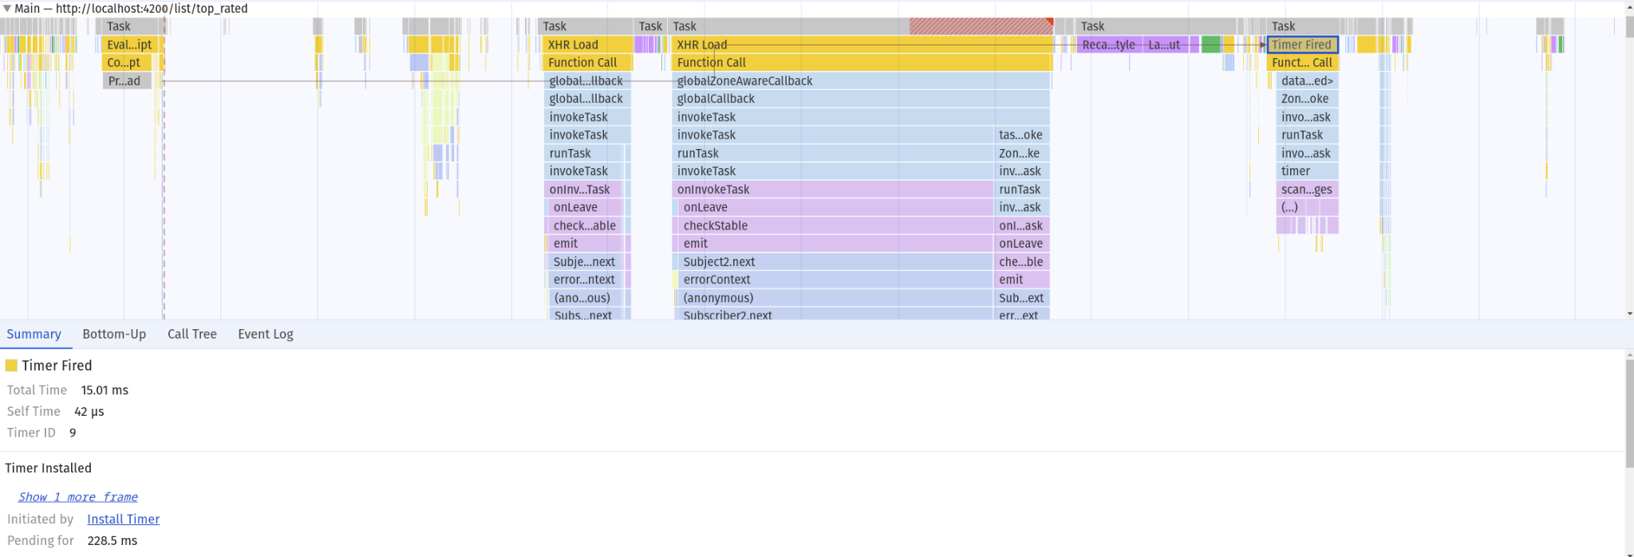
Main
Follow asynchronous tasks

Slide 46
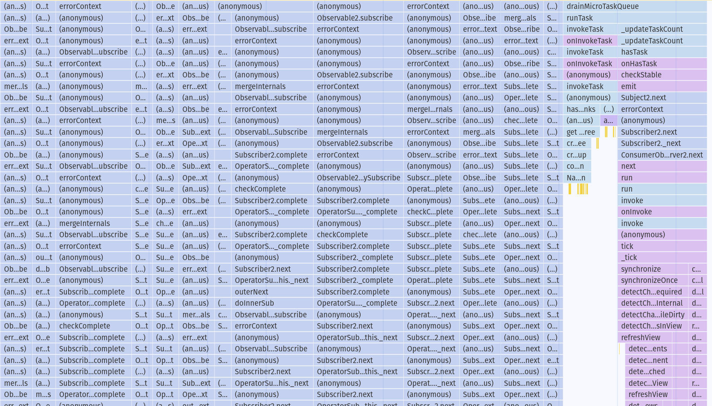
Main
Sampler inaccuracy

Slide 47
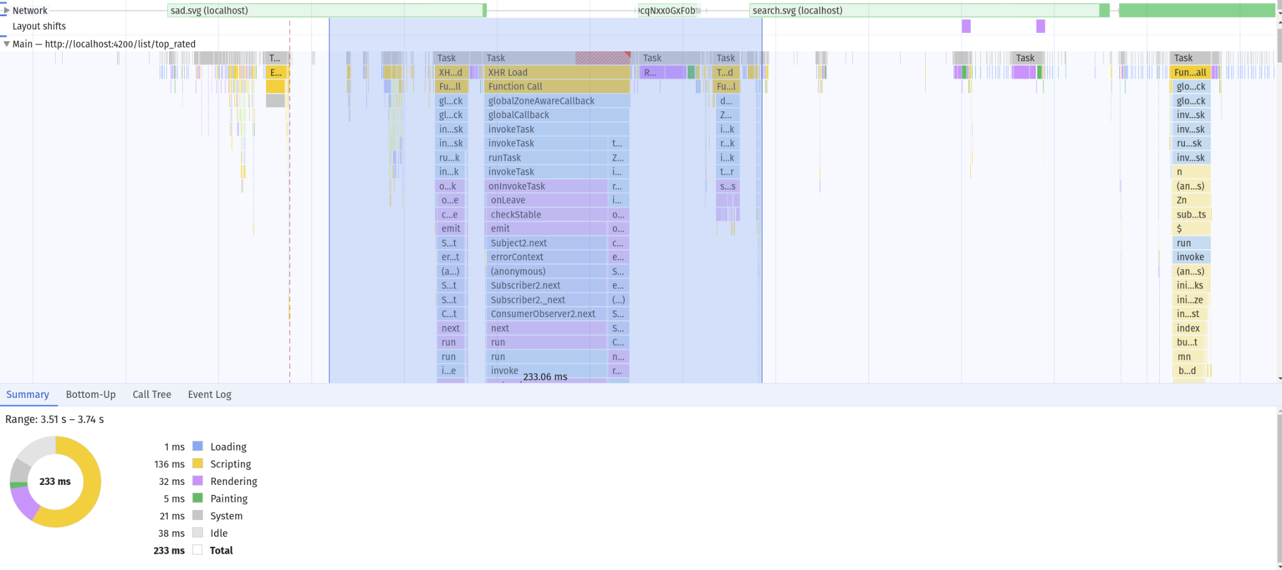
Main
🖱️
Shift
+
drag

Slide 48
Tracks are CONNECTED!

Slide 49
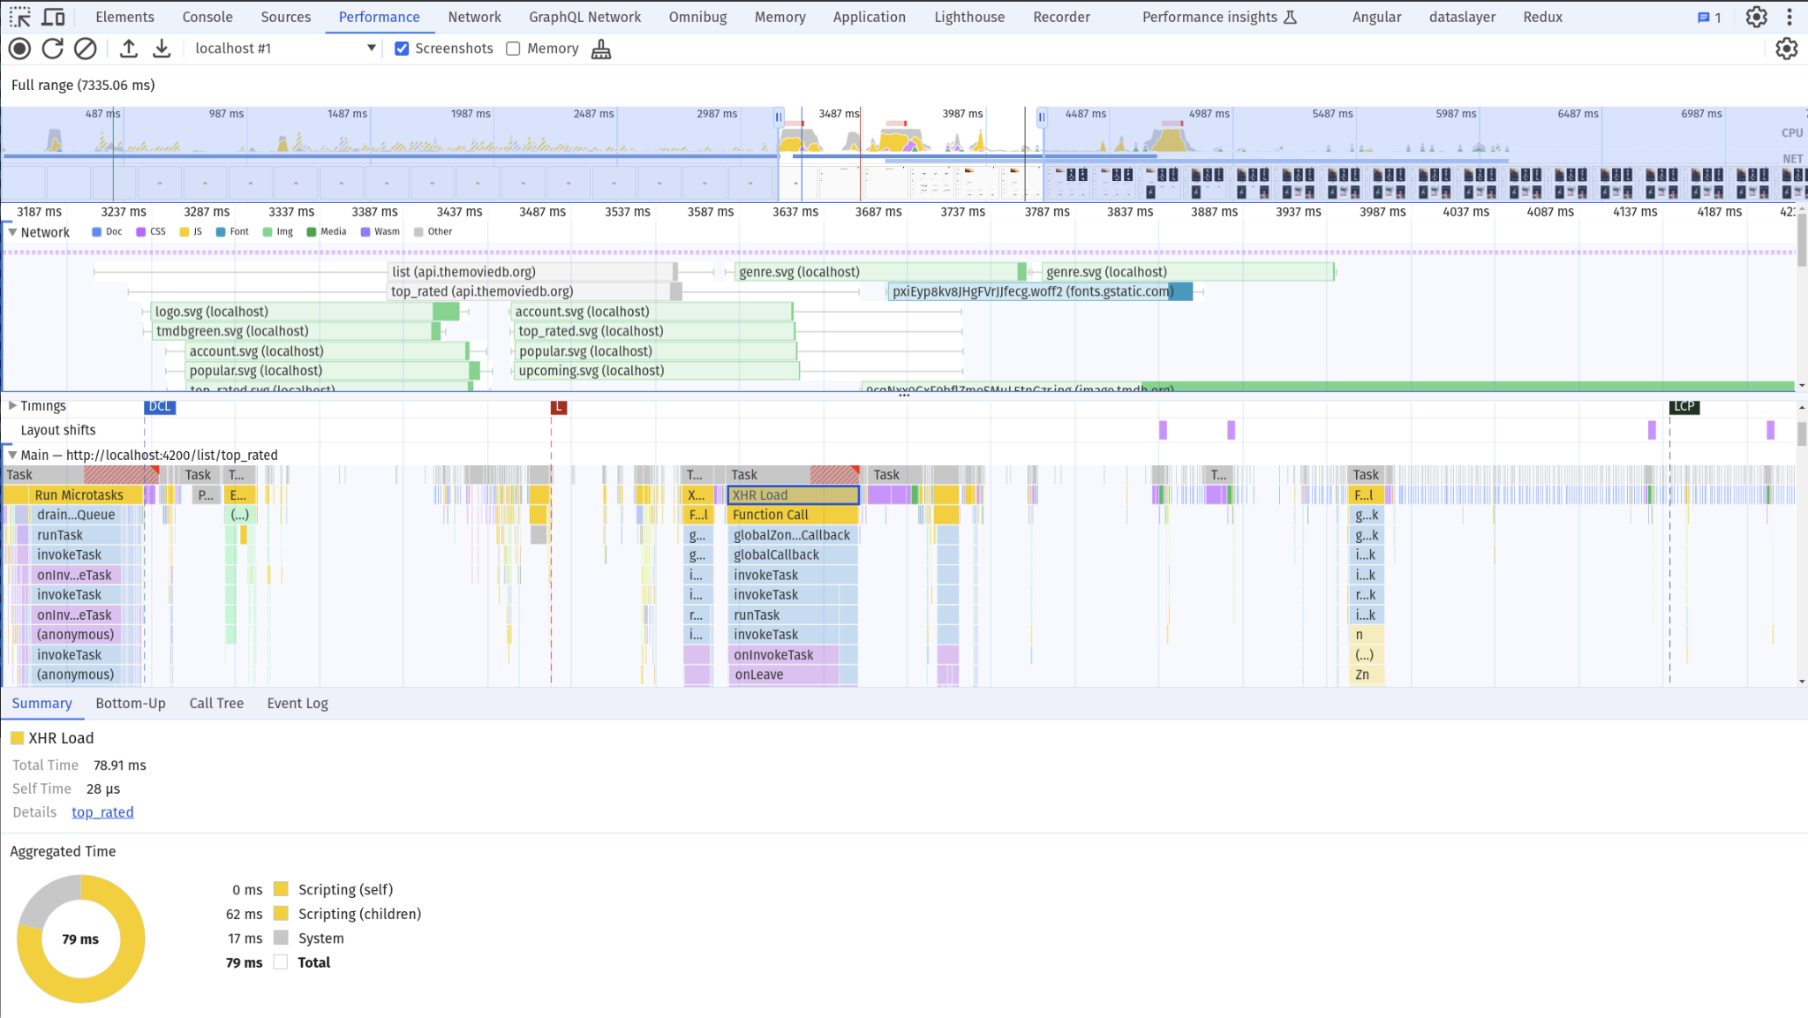

Slide 50
Timings

Slide 51
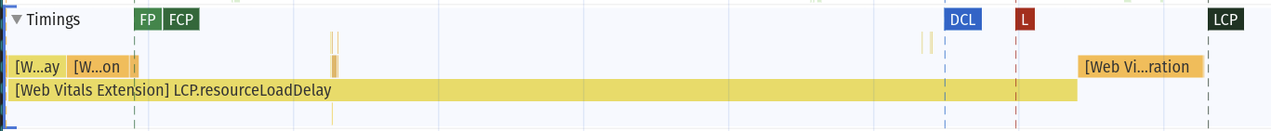
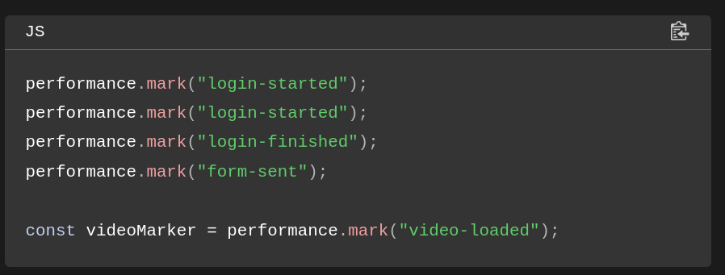
Timings
DOM Events + Web Vitals
Custom events

Slide 52
Frames

Slide 53
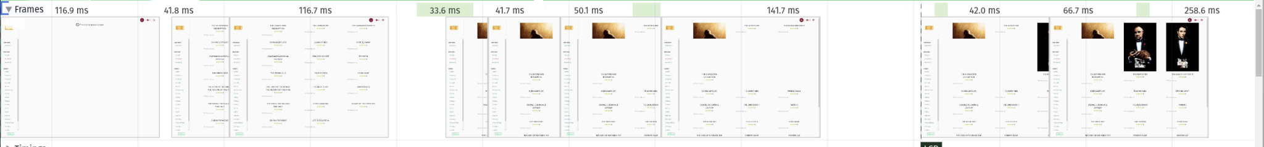
Timings
Frame generation time
33ms ~~ 30fps
16ms ~~ 60fps
generated frames

Slide 54
Search

Slide 55
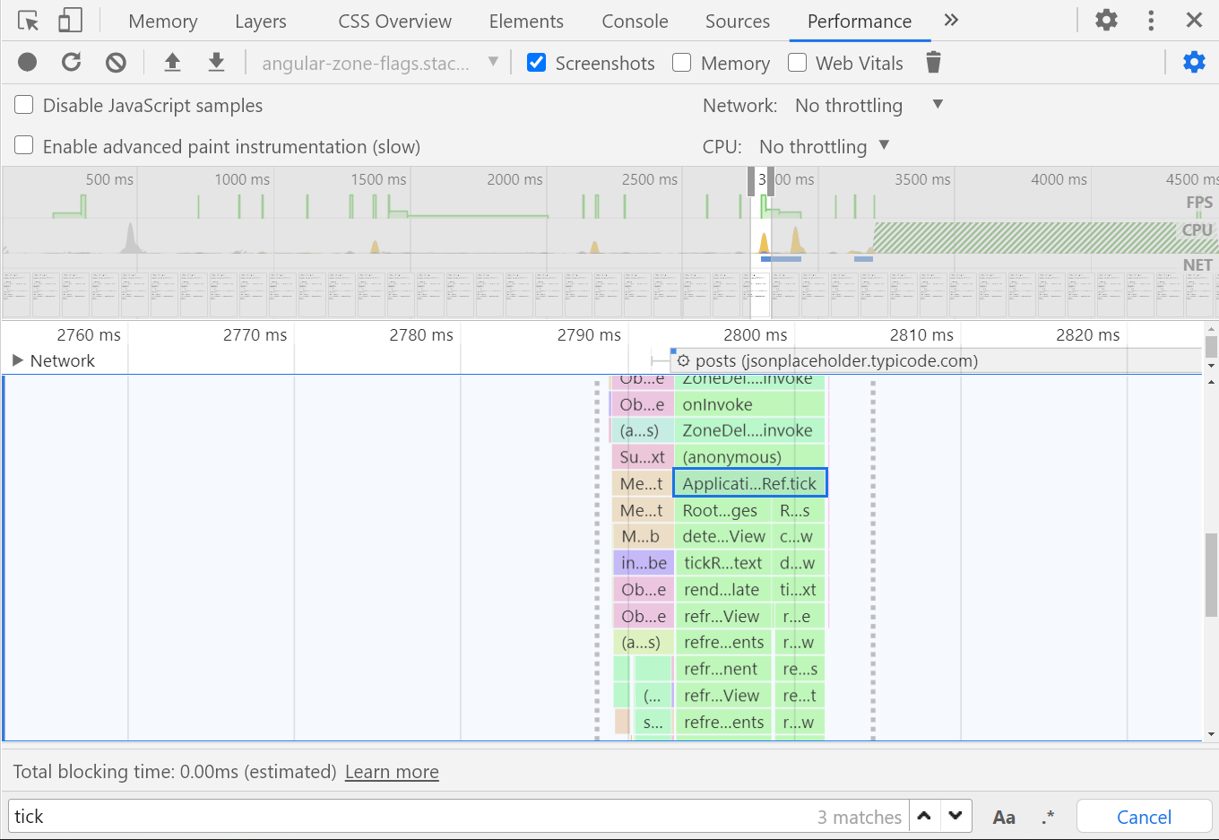
Search in performance profile
Ctrl
f
Enter

Slide 56

Demo & Exercise
Time!
Performance Tab & Flame Chart analysis

